Slide 1

Data Compliance for your database

Slide 2



BIO
Christopher Wolff
Working with databases since SQL 2000
Twitter: @tickytong
Email: tickytong@gmail.com
Blog: https://chriswolffdba.wordpress.com/
Senior DRE at Xero
MS and AWS Certified

Slide 3
Objectives
Defining Data Compliance
Classifications of data
Removal of Data…or not
Overview of the legal issues and laws

Slide 4
Data Compliance
Data Retention
Defined by the policies of persistent data and records management for meeting legal and business data archival requirements.
Balancing act between legal and privacy concerns and economics and need-to-know concerns
Determines the retention time, archival rules, data formats, and the permissible means of storage, access, and encryption
Different meanings depending on the industry

Slide 5

Legal Issues
Regulatory Compliance
Laws, policies, and regulations that data compliance falls under
Can vary widely depending on the region of the world an entity does business in
Accrediting organizations to help entities navigate through the regulatory items

Slide 6
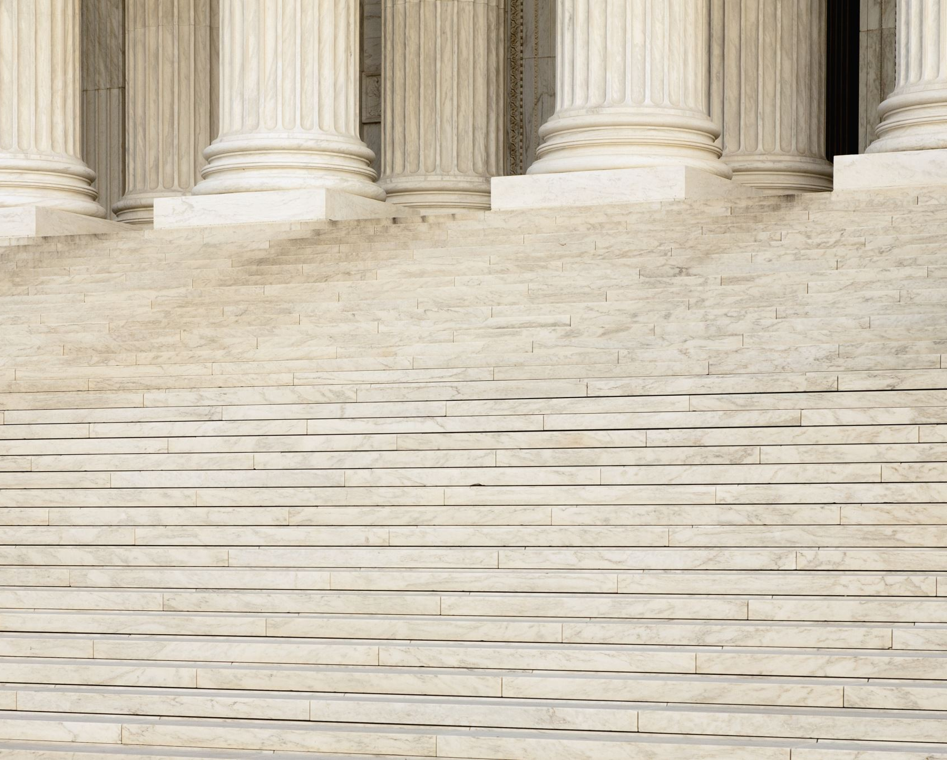
Laws
Whole host of laws around the world
Main one most entities use as a standard is the EU General Data Protection Regulation (GDPR)
“Lays down rules relating to protection of natural person with regards to the processing of personal data and rules relating to the free movement of said data”
Only applies to citizens of the EU and member states
Many other location have used this laws as a framework, such as the California Consumer Privacy Act (CCPA)

Slide 7
Three Main Points of GDPR
Consent
Data Minimization
Individual Rights
Getting consent to collect personal data
Only keeping data having to do with a well-defined business objective
Gives clear rights to understand why their data is being collected and processed

Slide 8

Classifications of Data
Most regulations cover what is called Personal Identifying Information (PII)
Any representation of information that permits the identity of an individual to whom the information applies to be reasonably inferred by either direct or indirect means
Applies to any employee or customer of an entity

Slide 9
Examples of PII Information
Phone Number
Email Address
Website URL
Blogsite
Facebook
LinkedIn
Twitter handle
Name
First, last or both
Government ID
Tax ID
Social Security Number
Location data
Address
Google maps info
Latitude and Longitude

Slide 10

Removing Data
Identify where PII data exists in your database
Good candidates are customer or employee tables
Order information can also hold location data or email information
Data outside the database
Object storage services like S3 in AWS
May contain photos or important personal documents
Image credit: https://www.chicagotribune.com/resizer/wZU7RC95QaTC0w7CYTh_S5dzmA4=/800x607/top/arc-anglerfish-arc2-prod-tronc.s3.amazonaws.com/public/N5ZTRI54VZDAZEHOWIZZQ4DXS4.jpg

Slide 11

Automating Removal of Data
Repeatable process to delete data
PowerShell script that covers all the tables and locations of data that must be removed
API that runs through all these locations and can be called by a customer ID

Slide 12

…or not
Backups
Most regulators have given backups a pass
Satisfied with backup data being considered “beyond use”
Breaking schemas
If a database requires the ID of the user to exist, alterations of the string data may be required
Change name to “userrequestdelete”

Slide 13
Question?
Full list of laws around the world
https://cloud.netapp.com/blog/data-compliance-regulations-hipaa-gdpr-and-pci-dss
GDPR law in full
https://gdpr-info.eu/art-2-gdpr/
PII Definition by US Department of Labor
https://www.dol.gov/general/ppii
Information about backups
https://hallboothsmith.com/we-all-know-about-gdprs-right-to-erasure-does-this-mean-you-have-to-delete-data-from-backups-as-well/
Related topics from Wikipedia
https://en.wikipedia.org/wiki/Regulatory_compliance
https://en.wikipedia.org/wiki/Data_retention
Read more about this on my blog!
https://chriswolffdba.wordpress.com/2021/10/10/data-compliance-for-your-database/

